Slide 1
Week 6 mid-term revision
Multiple choice questions : The main idea, details, inference
Short answer questions/ Open-ended questions

Slide 2
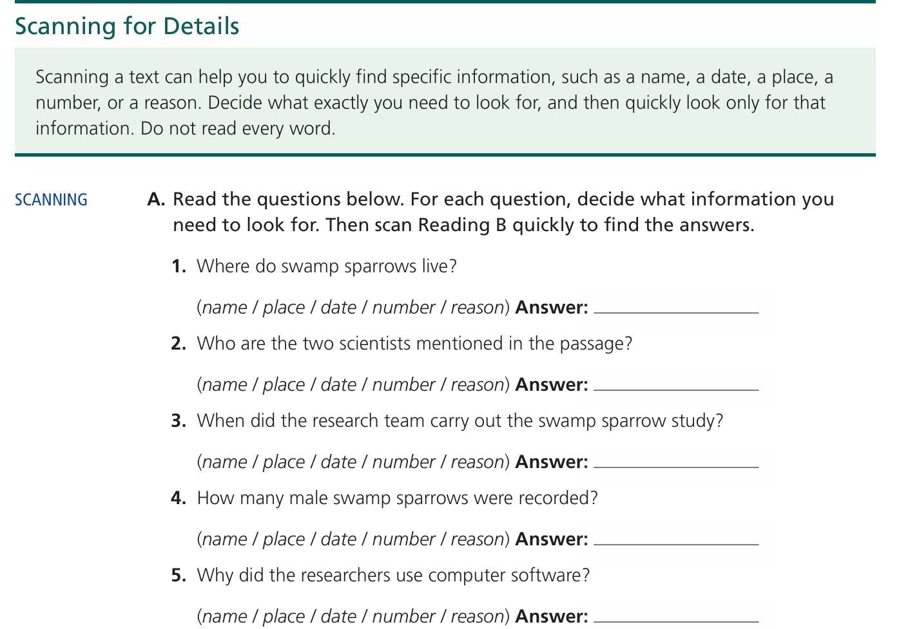
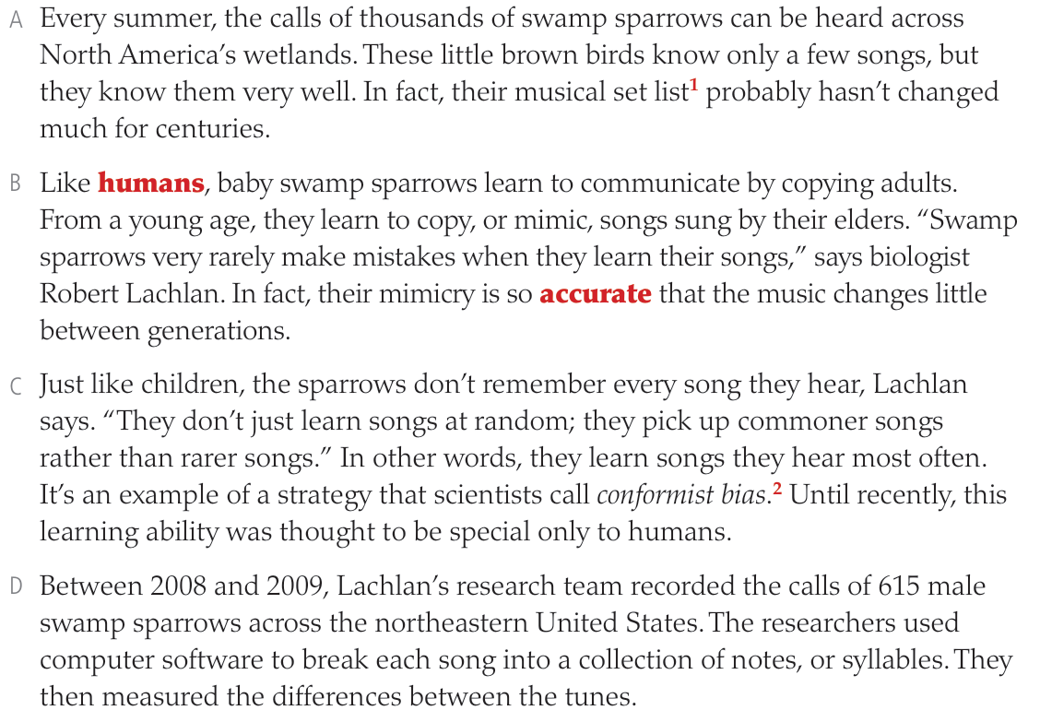







Short answer questions
North America’s wetlands

Slide 3
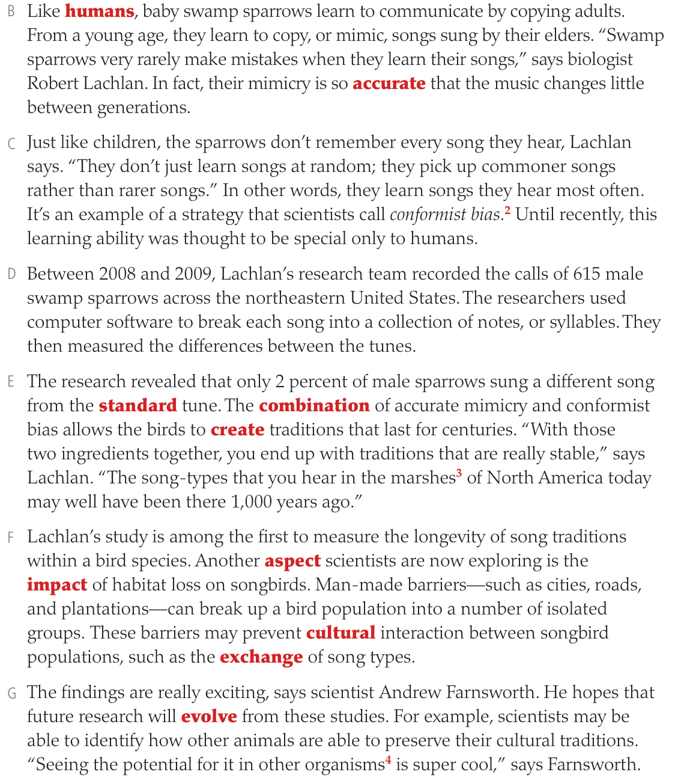


Short answer questions
North America’s wetlands
Robert Lachlan, Andrew Farnsworth
Between 2008 and 2009
615
* To break each song into a collection of notes
* To break each song into syllables

Slide 4

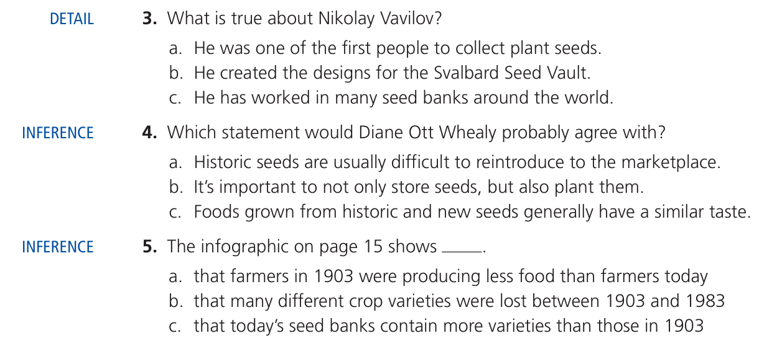
MCQ – main idea/ details/ inference

Slide 5
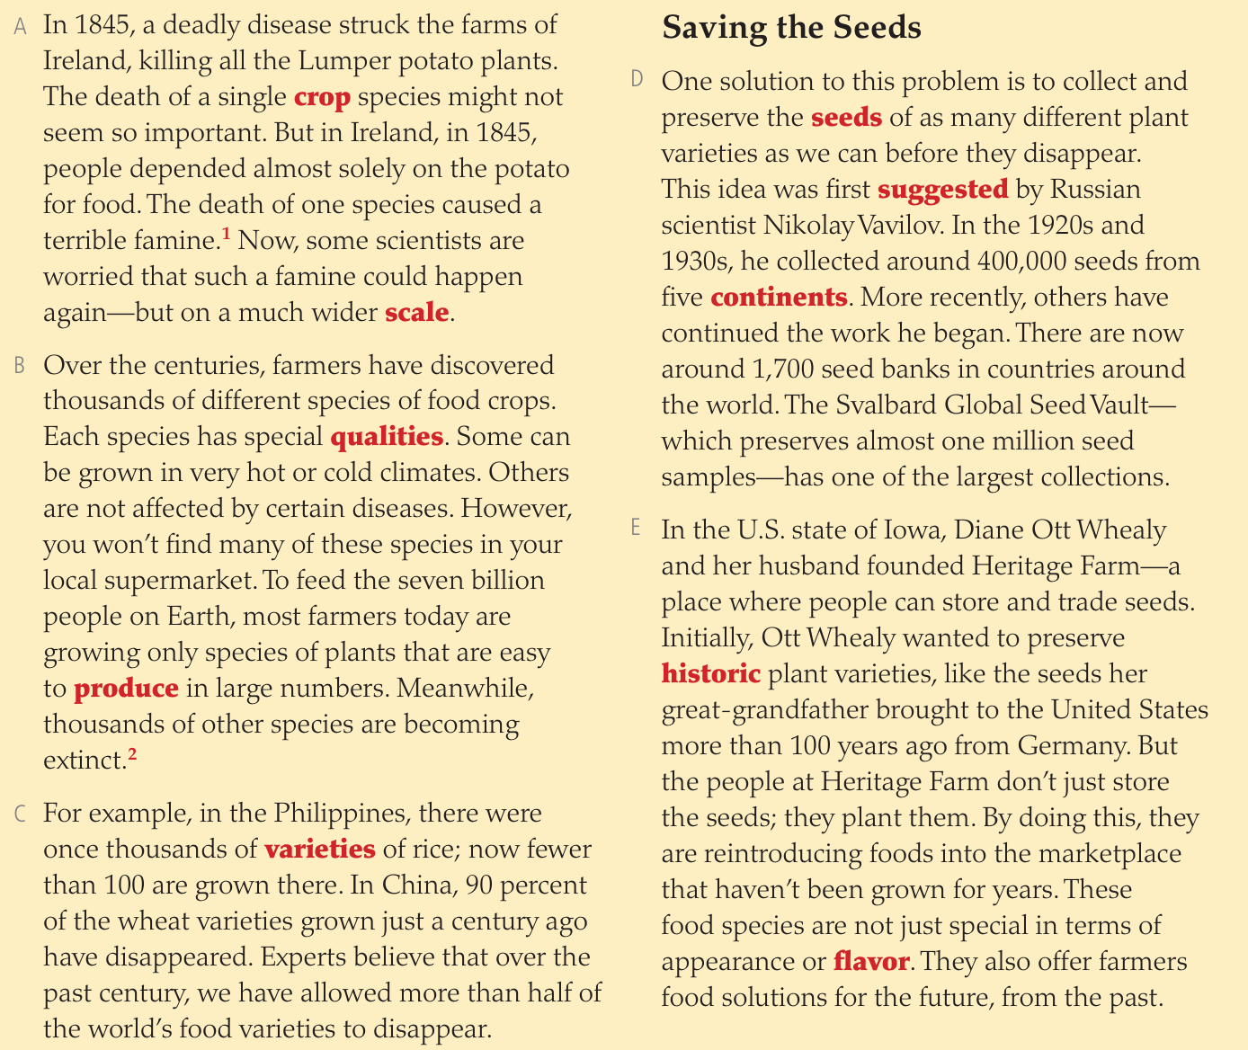








Slide 6
Pilot test – midterm revision

Slide 7
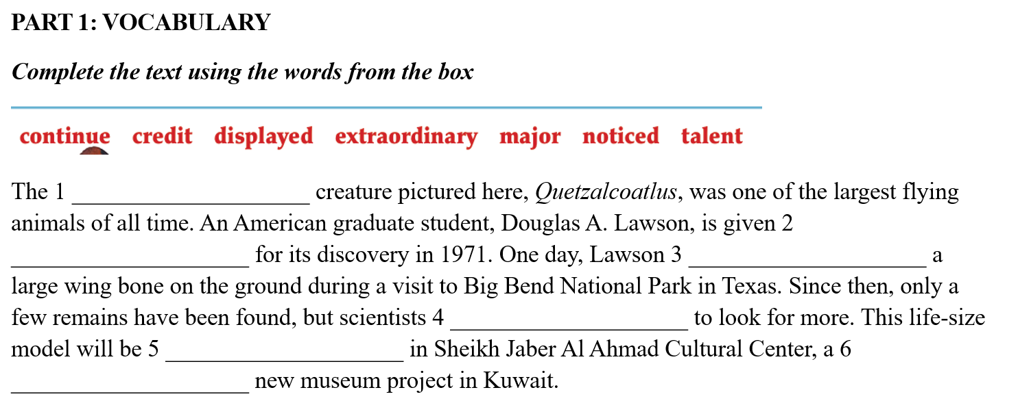
extraordinary
credit
noticed
continue
displayed
major

Slide 8
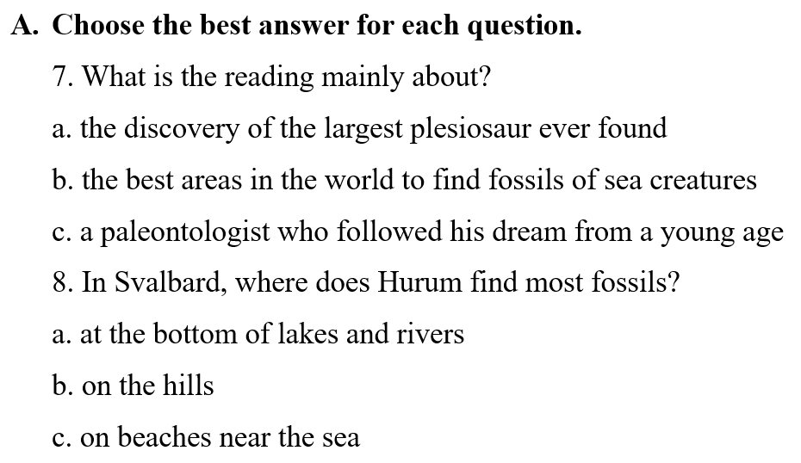







Slide 9
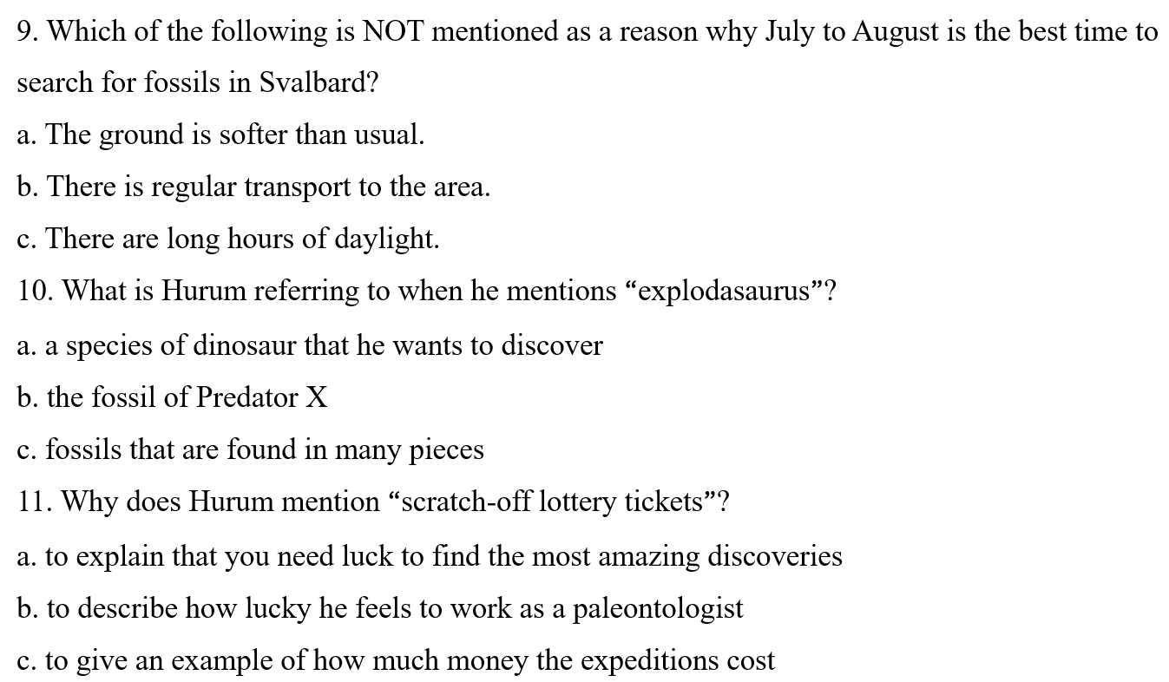
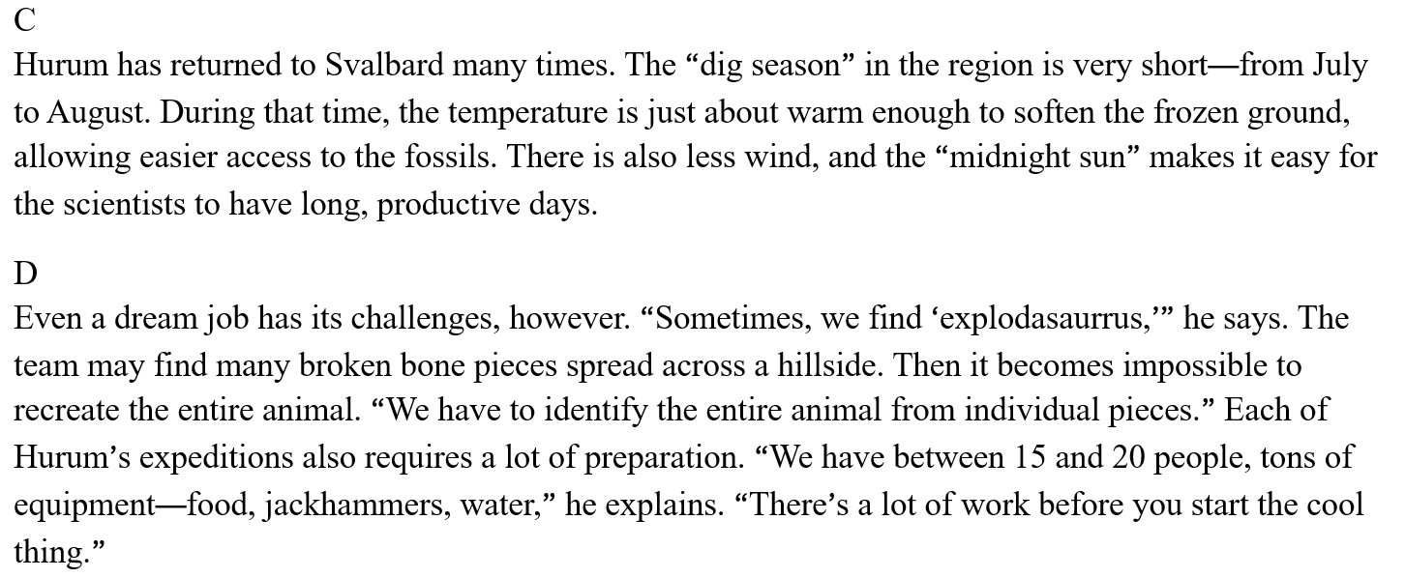











Slide 10
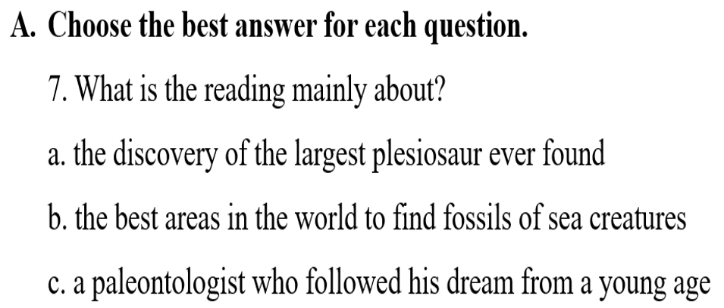


Slide 11







In his bedroom
The “dig” season

Slide 12










Food, jackhammers, water
By hand

Slide 13
